Slide 1
Covid-19: Italy’s phase 2
Emanuele Lanzani
09/05/2020

Slide 2
Which provinces are the safest to open?
Our problem:
-differentiate provinces based on infected, density, population, risky venues
-is it possible to get the economy going while still waiting in the riskier provinces?
-we don’t want to sacrifice lives for the sake of the economy
-we also don’t want to destroy the economy in the process

Slide 3
Our goal
-We will collect different data from different sources
-We will create different provinces clusters to understand which ones are the safest
-We will also try to understand if there are some provinces which may possibly require harsher restrictions

Slide 4
Data
Data from wikipedia Italy’s provinces
Data from the italian health ministry website, with up to date infected numbers
Venues Data from FourSquare

Slide 5
Methodology
Get provinces data
Wrangle it to clean some format errors
Get infected data (this proved difficult and required a csv conversion)
Wrangle it to get the correct dataframe
Merge the two dataframes together
Retrieve provinces’ coordinates with geocoder package
Create folium map
Retrieve foursquare venues
Merge the dataframe with the other two
Standardize infected, venues, population and density fields
K-cluster the new standardized dataframe
Project the cluster on the folium map

Slide 6
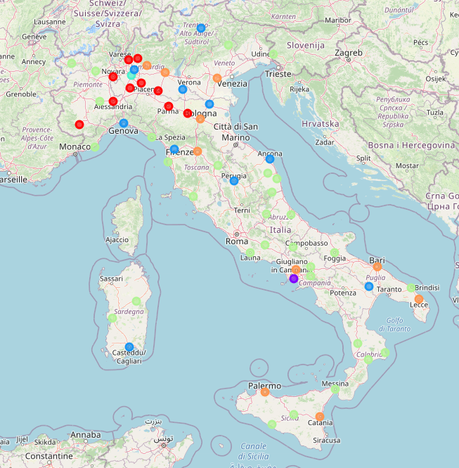
Results
Cluster 0 (red circles): infected are in the thousands. Venues, density and population are average
Cluster 1 (purple circle near the center): infected in the thousands, but outlier density
Cluster 2 (light blue): high number of venues, compared to other clusters
Cluster 3 (turquoise in the north): high density, high population, high venues and extremely high infected
Cluster 4 (light green): mid low density, mid low infected, mid low venues
Cluster 5 (orange): high population, average density, mid high venues

Slide 7
Conclusions and Recommendations
The safest group to undertake some risks with is cluster 4: they present a relatively low density, a relatively low number of venues, and a relatively low number of infected. Definitely areas where the virus is not widely spread and the density is not that high.
On the other hand, cluster 2, which includes just Milan, presents the highest risks and therefore further restrictions should be considered.

Slide 8
Thank you!

